Slide 1

Smart Village
Rural Rehabilitation Project
Target Area
Venkatapuram Village, Metu Colony,
Ward - 8, Kanchipuram District, TamilNadu.
Project Duration
Three years

Slide 2
Our Team
Meena Mohan
Chitra Gopinath
Dr. Renuka David
Naina Shah
Sakshi Sahoonja
Student group (leader - Armaan Goyal)
Advisor
Padma Venkatraman,
Women’s India Association, President

Slide 3
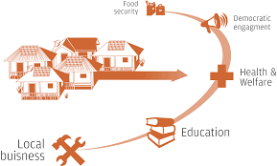
Get Inspired - SMART VILLAGE A concept adopted worldwide.
All we need is to apply the right concept in the right place

Slide 4
Our Focus
Make this village self sustaining,
with a good quality of life

Slide 5
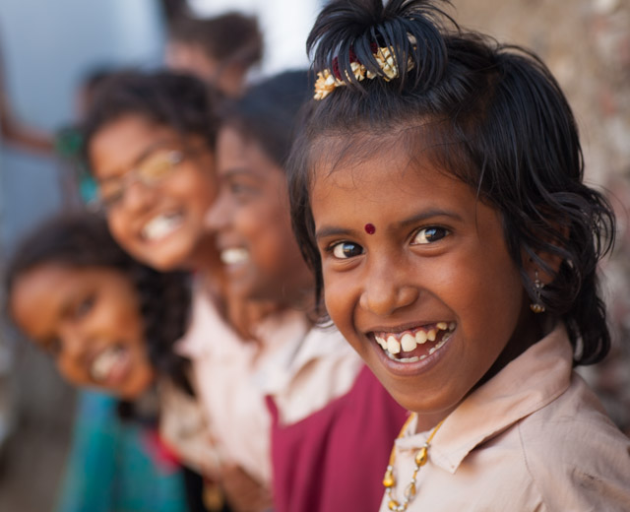
Children- THEIR FUTURE Our first priority will be the welfare of Children in the village.
Secure the Future of this village.

Slide 6
Children - THEIR FUTURE – Ideas
100 % Education for all the children
Special after school tuitions
Special Sport Coaching eg.Volley ball, Basketball court,
Cricket, etc
Children’s playground
Library
Nutrition to Children
Tie up with colleges to support college going children
Skills building
Placements
Digital Education

Slide 7
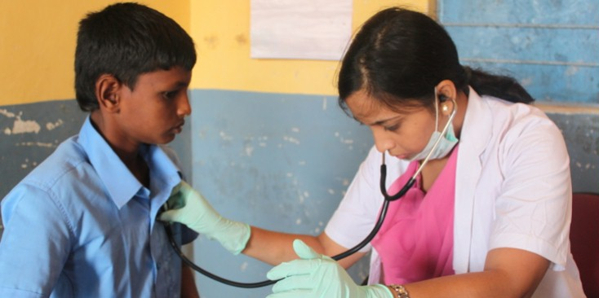
Health & Hygiene For a Future free from disease and illness.

Slide 8
Health & Hygiene
Creating Community Health Centre
Tying up with SRM Medical College
Medical Camps with different NGO's Health and Hygiene Awareness programs in :-
Pediatrics
Gynecology
Diabetics
Psychiatrist
Cancer

Slide 9
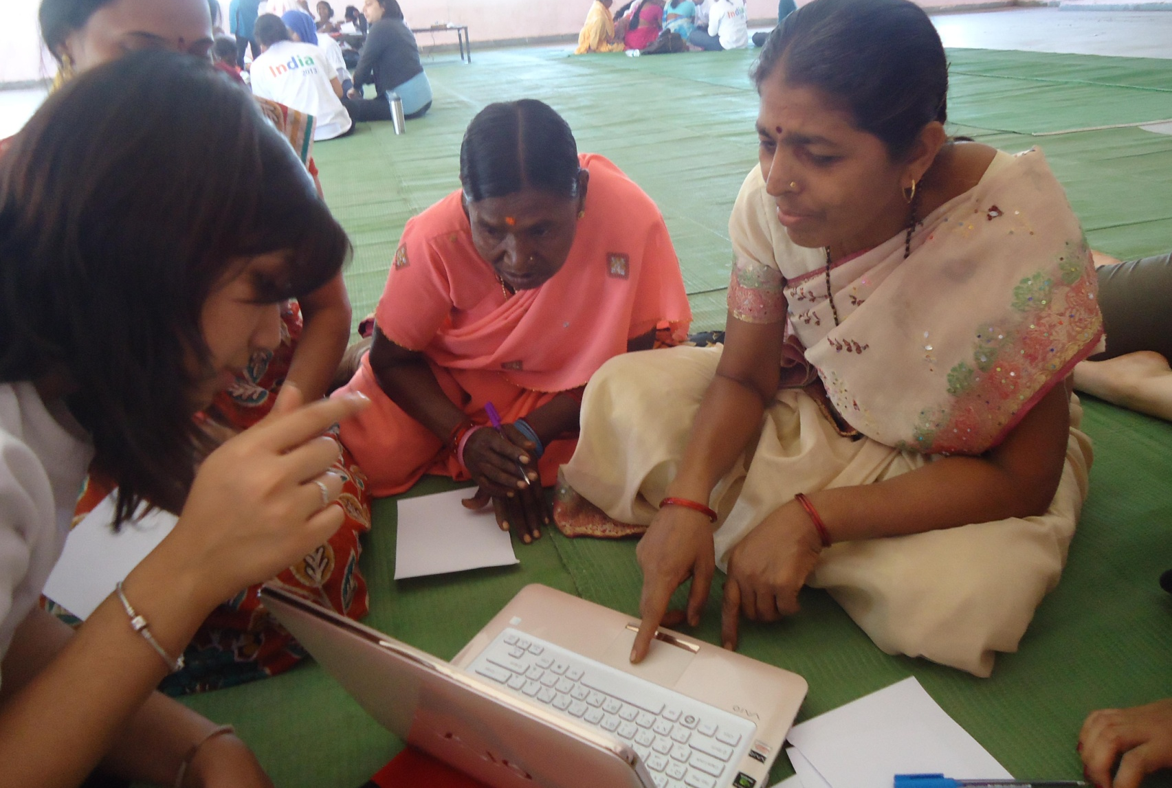
Empowerment of Women Securing the backbone of the village

Slide 10

Women Empowerment Ideas
Micro Finance for income generation, by tying-up with
microfinance
Skill Building
Tailoring unit training & certification,
Income generating crafts
Sanitary napkins making & marketing
BP & Diabetic testing

Slide 11
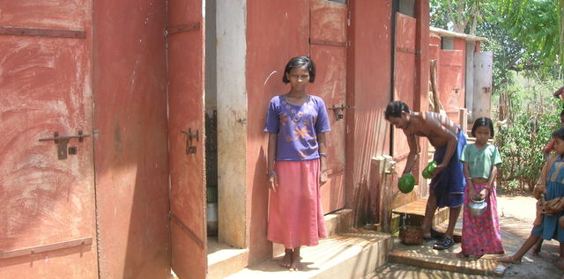
Sanitation
A clean surrounding for a cleaner future

Slide 12
Sanitation - Ideas
Building Toilets
Waste Water Management
Garbage Management

Slide 13
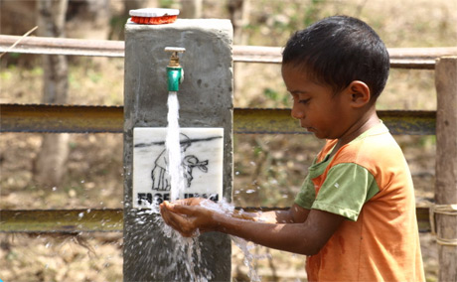
Environmental Awareness Feel responsible towards your environmental

Slide 14
Sanitation - Ideas
Planting of more trees
Garbage Management
Clean Water
Solar Power
Saving Electricity Consumption Ideas, like usage of CFL,
LED, etc.

Slide 15
Ideas in the Pipeline
Men Skill Building
Lifestyle and Environmental Awareness
Access to Market and Marketing
Agriculture Awareness
Digital Creativity
Micro Credit for Income Generation

Slide 16

How do we plan to raise the money?

Slide 17
Getting the Funds - Ideas
Fund Raising Events
Raising funds from Big Corporates with CSR
budgets
Flo Members contribution
Other NGO collaboration

Slide 18
Its just the beginning…
Our goal is to help the smart village thrive and also ensure that it self sustains.
Let us join together now, contributing whatever we can – materials, funds, labour, or any other resources. Together nothing is impossible!
THANK YOU!

Slide 19
Contact us:
Meena Mohan | 9841562783 | meena.mohan05@gmail.com
Chitra Gopinath | 9840055216 | chitragopinath@hotmail.com
Dr.Renuka David | 9840982552 | md@radiantmedicalservices.com
Amrit Rattha | 9841018885 | amritrattha@hotmail.com
Naina Shah | 8754502493 | chennaismartvillage@gmail.com
Sakshi Sahoonja | 9790889999 | sahoonjasakshi@gmail.com

